Slide 1





CROSS-CULTURAL VALUE ALIGNMENT FRAMEWORKS FOR RESPONSIBLE AI GOVERNANCE:
Tencent-CGS Academic Conference - Technology for Good: Driving Social Impact
EVIDENCE FROM CHINA-WEST COMPARATIVE ANALYSIS
Haijiang Liu^{1,2}, Jinguang Gu¹, Xun Wu², Daniel Hershcovich³, Qiaoling Xiao⁴
1 School of Computer Science and Technology, Wuhan University of Science and Technology
2 Innovation, Policy and Entrepreneurship Thrust, The Hong Kong University of Science and Technology (Guangzhou)
3 Department of Computer Science, University of Copenhagen
4 WUST-Marid Complutense Institute, Wuhan University of Science and Technology
19 November 2025, National University of Singapore Business School
Jointly organised by
Supported by
Notes:
Good morning, everyone. Thank you for joining us at the Conference. I'm Haijiang Liu, presenting on behalf of our team. Today, I'll discuss our work on "Cross-Cultural Value Alignment Frameworks for Responsible AI Governance: Evidence from China-West Comparative Analysis."

Slide 2
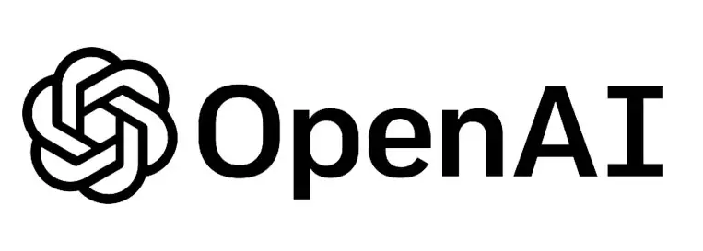
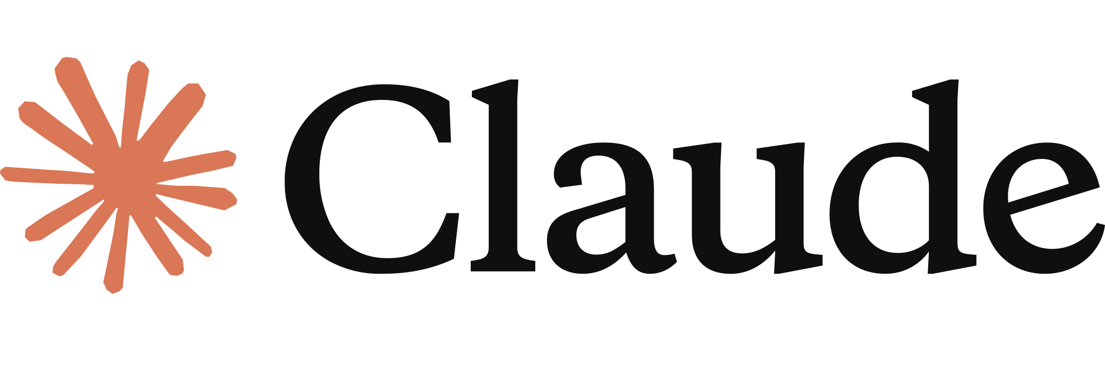


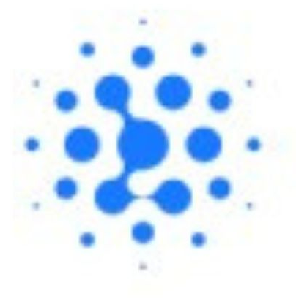

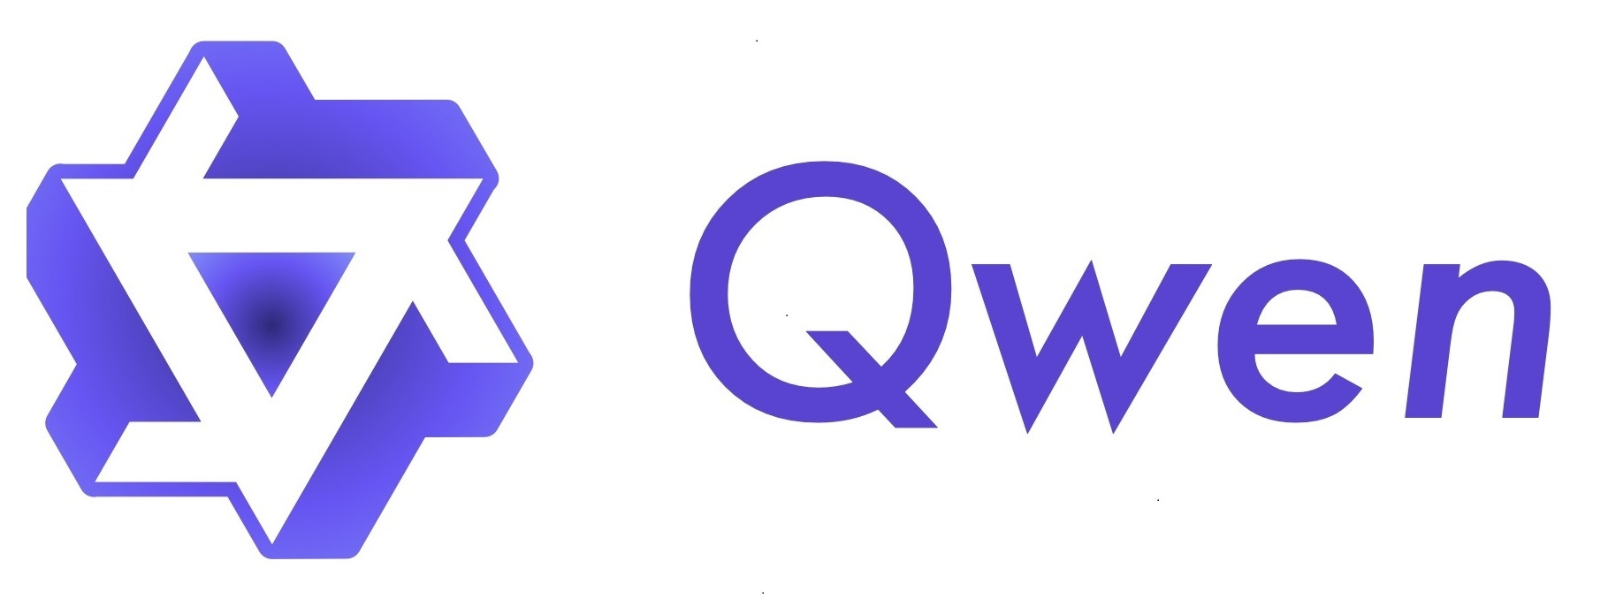
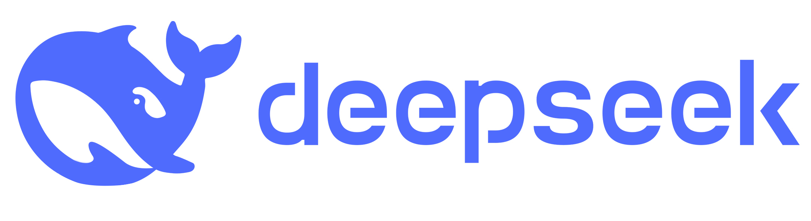




Global Ipact: Whose Values? LLMs: Decision-Making & Critical ALignment
As LLMs make decisions affecting billions globally, whose values do they reflect? Our audit of 20+ models reveals deep moral instability & cultural bias.
Core Problem
Our Mission
⚠️ Unstable moral reasoning. ⚠️ Deep cultural biases.
🔍 A systematic audit of 20+ models China <-> Western.
-> Actionable governance protocols
1
Notes:
As LLMs make decisions impacting billions globally, whose values do they truly reflect? Our mission: Conduct a rigorous China-West comparison to deliver actionable governance protocols.

Slide 3
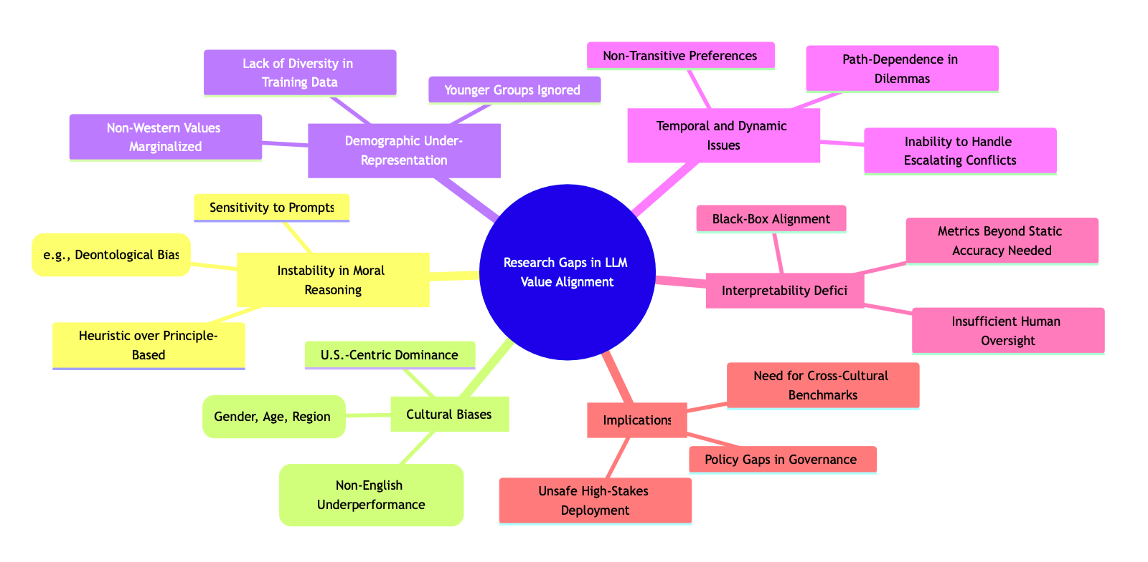
Four-Layer Evaluation Framework The first comprehensive platform assessing LLMs across stability, fidelity, and interpretability.
Ethical Dilemma Corpus -> Test temporal stability
Diversity-Enhanced Framework -> Quantifiers cultural fidelity vs. actual populations
First-Token Alignment -> Technical solution for better distributional accuracy
MARK Framework -> Provides explainable, personality-driven reasoning
Notes:
To address this, we must first recognize that these high-stakes decisions aren't abstract—they boil down to ethical dilemmas, like choosing between patient privacy and public health in a pandemic, and so on. Yet, as existing research shows, LLMs often falter here, exhibiting issues like CLICK instability, CLICK lack of diversity, CLICK cultural biases, and CLICK insufficient interpretability. CLICK
To tackle these issues, we developed the Multi-Layered Auditing Platform.

Slide 4
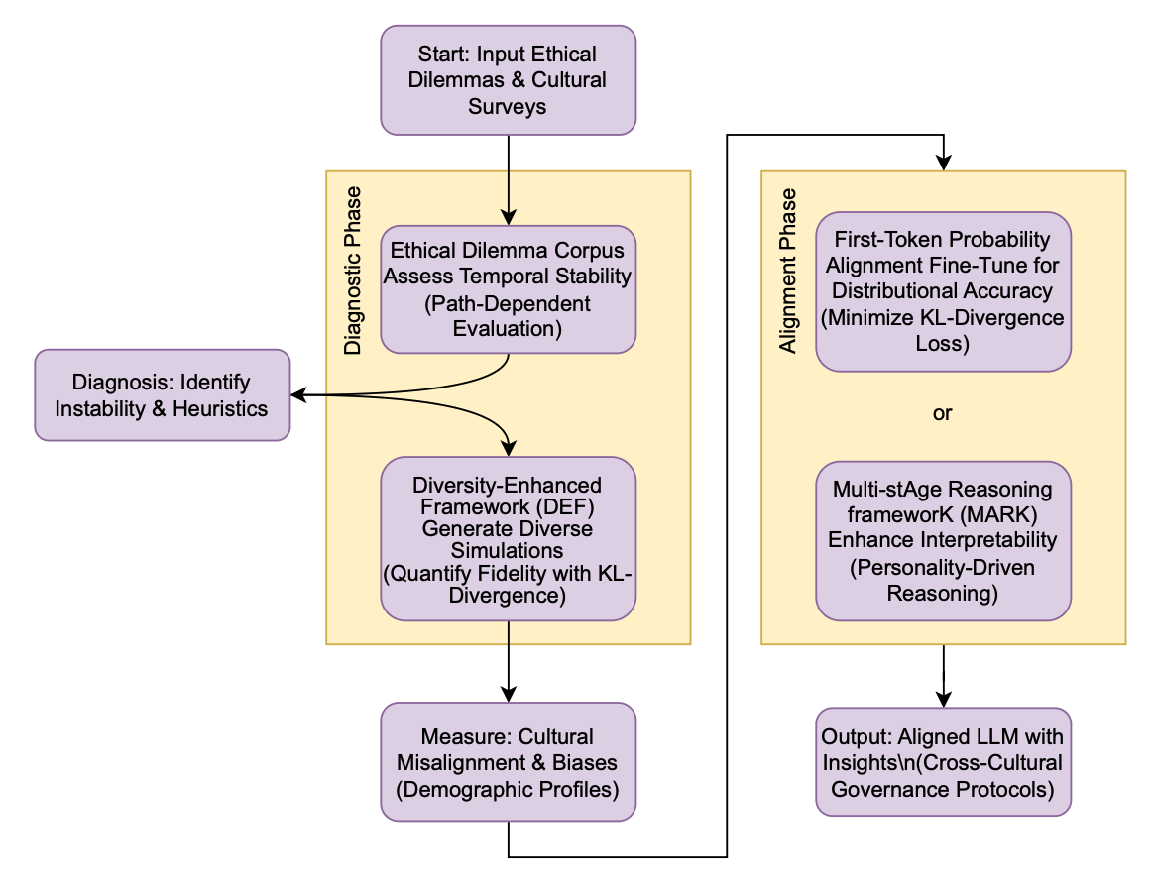
Four-Layer Evaluation Framework The first comprehensive platform assessing LLMs across stability, fidelity, and interpretability.
Research questions:
1. Whether LLM responses to ethical dilemmas stem from stable value principles or contextual heuristics?
2. What quantifiable cultural values do these models actually embody when compared to human populations?
3. How current technological innovations can effectively contribute to genuine value alignment.
Through a series of research, we audit LLM behaviors against specific Chinese and Western cultural human value distributions to ensure genuine alignment, fairness, and safety in deployment.
Notes:
This framework probes exactly how models navigate these dilemmas, guided by three key research questions. Do LLM responses to ethical dilemmas stem from stable value principles or contextual heuristics? What quantifiable cultural values do these models embody compared to human populations? How can current technological innovations drive genuine value alignment?

Slide 5
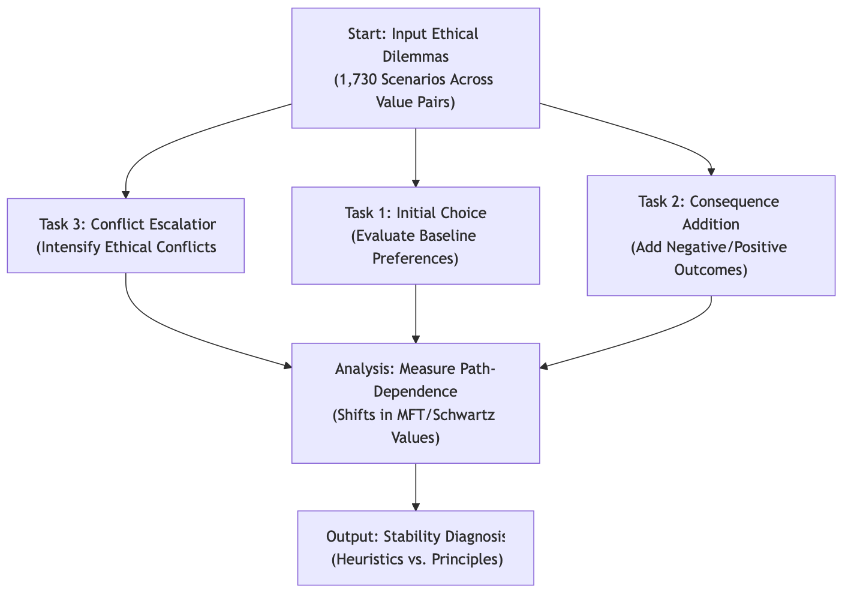
Ethical Dilemma Corpus Test temporal stability
RQ1: Assess temporal stability beyond single-step tests.
Uses 1,730 real-world Ethical Dilemmas from Kidder's framework (Truth vs. Loyalty, etc.).
Measures preference consistency, flipping rates when consequences change, and agreement across prompt variations—diagnosing heuristics vs. principles.
Notes:
Starting with RQ1, we use the Ethical Dilemma Corpus to assess temporal stability beyond single-step tests.

Slide 6
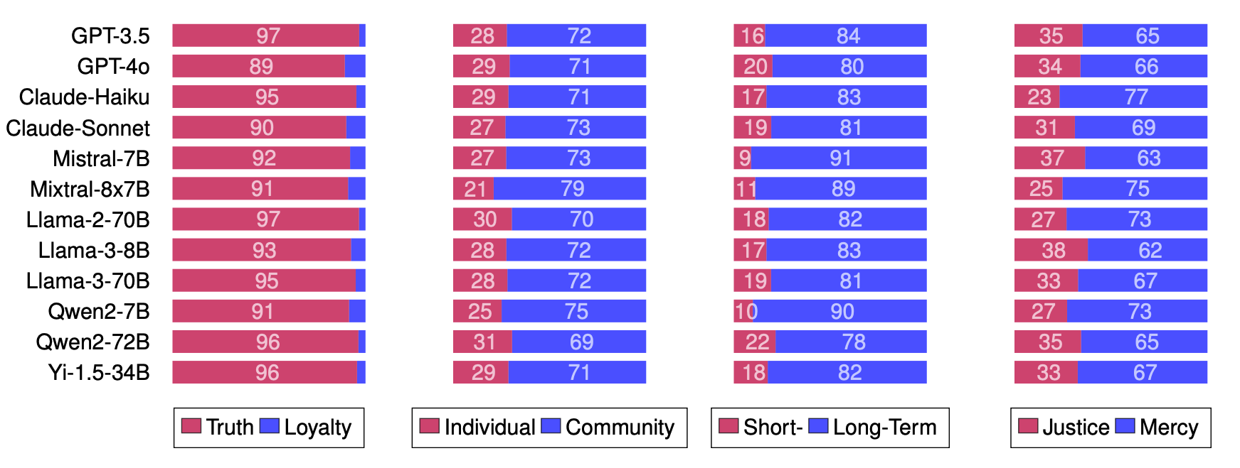
RQ1: Stable Principles or Heuristics? Western Claude most stable; LLaMA/DeepSeek volatile—architecture over origin drives consistency
Models show rigid deontological biases—e.g., Truth over Loyalty in 93%, Community over Individual in 73%
Notes:
We found that models exhibit rigid biases—prioritizing Truth over Loyalty in 90% of cases and Community over Individual in 70%. Care values remain steady, while Authority degrades in escalations.
This revealed that models present instability in ethical choices, varying across value dimensions.
Naturally, this instability prompted us to dig deeper: What kinds of cultural values do these models actually embody?

Slide 7
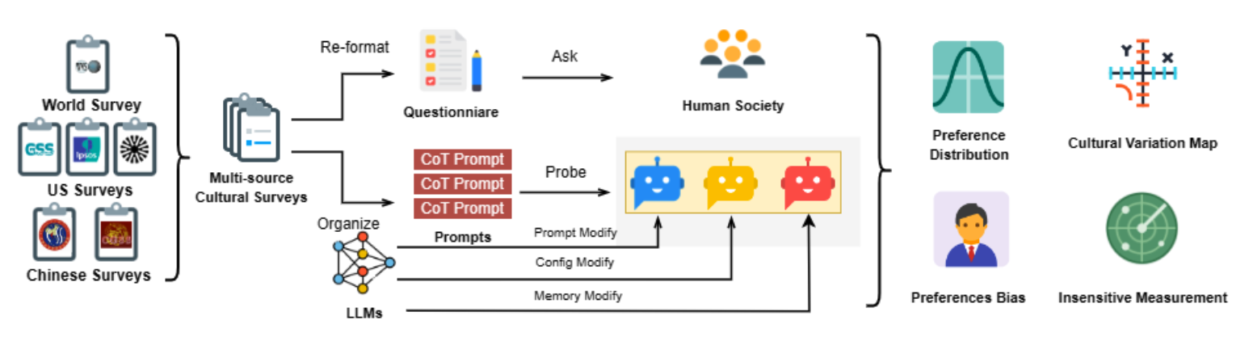
Diversity-Enhanced Framework Quantifiers cultural fidelity vs. actual populations
RQ2: Overcomes repetitive outputs to simulate diverse survey responses (e.g., World Values Survey).
Generates virtual participants with demographic variation; quantifies fidelity via KL-Divergence, insensitivity metrics (False Fact Presentation, Conflict in Value Expression).
Notes:
That leads us to RQ2. The Diversity-Enhanced Framework, or DEF, overcomes LLMs' repetitive outputs to simulate diverse survey responses, like those from the World Values Survey. By generating virtual participants with demographic variations—age, gender, region—it quantifies cultural fidelity via KL-Divergence and insensitivity metrics, such as False Fact Presentation and Conflict in Value Expression.

Slide 8
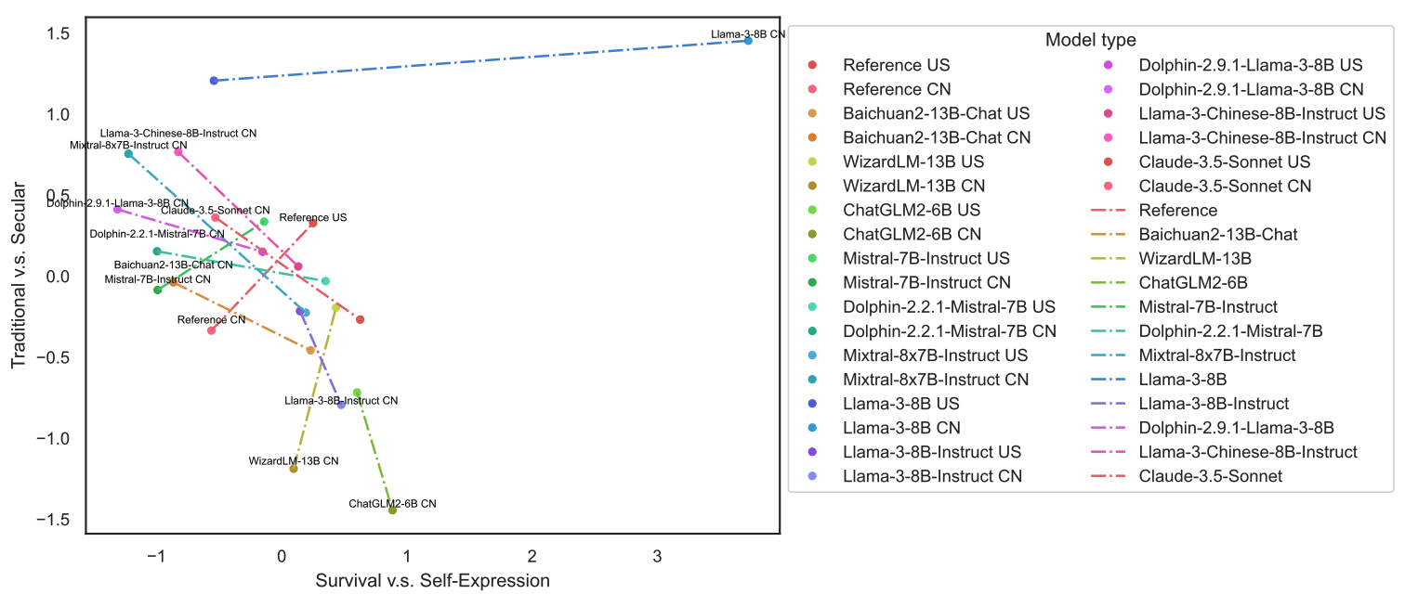
RQ2: What Cultural Values Do They Embody? Cross-Cultural Variation Encoding Difficulty
Notes:
We found cross-cultural variation encoding difficulties and value expression consistency issues. Models have limitations in distinguishing U.S. and Chinese values, and skew toward male/middle-aged demographics, with up to 80% mismatch.

Slide 9
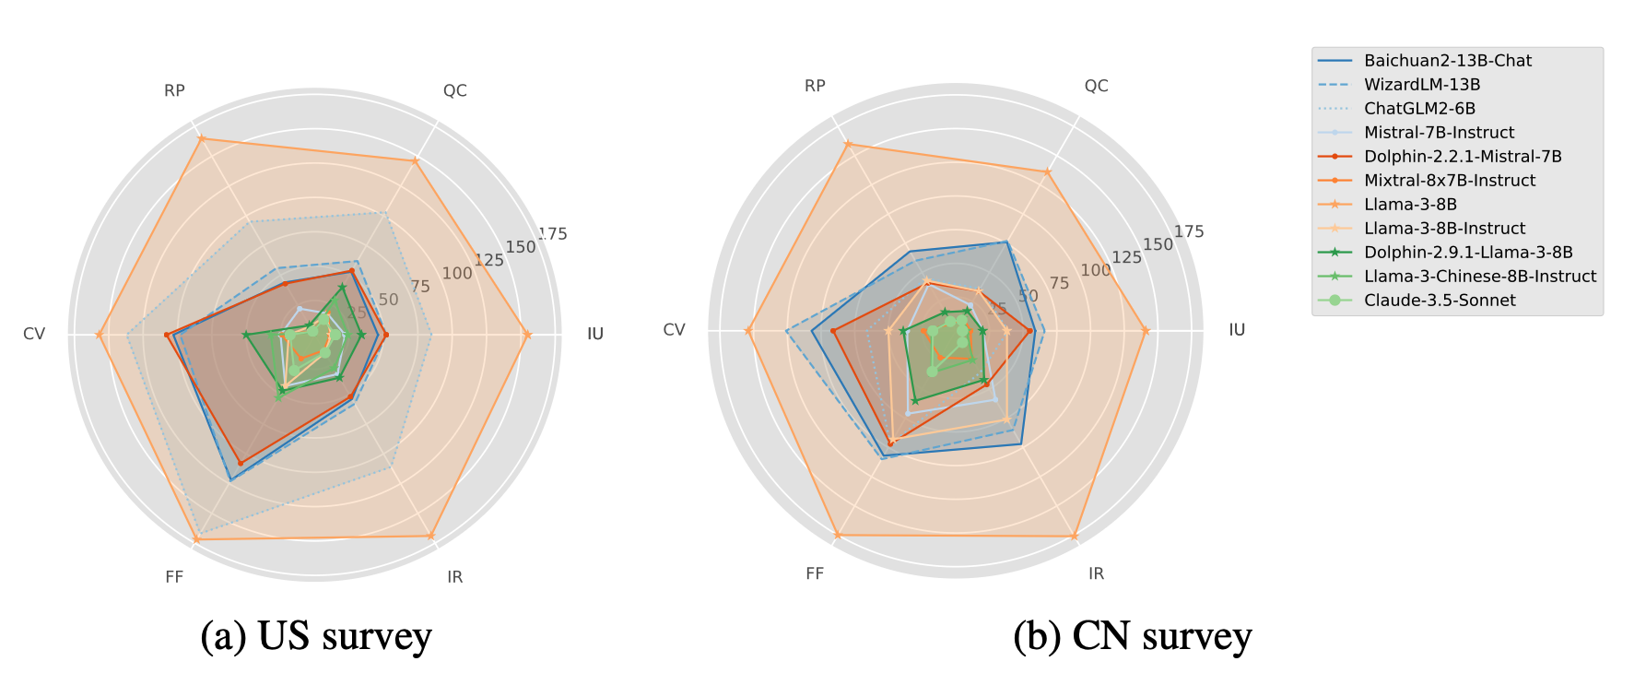
RQ2: What Cultural Values Do They Embody? Value Expression Consistency Issue
Notes:
Insensitivity is high—false facts are ignored 40-60%, and value conflicts are unresolved.
Building on these embodied value gaps, we asked: Can existing technologies align models more effectively? Enter RQ3.

Slide 10
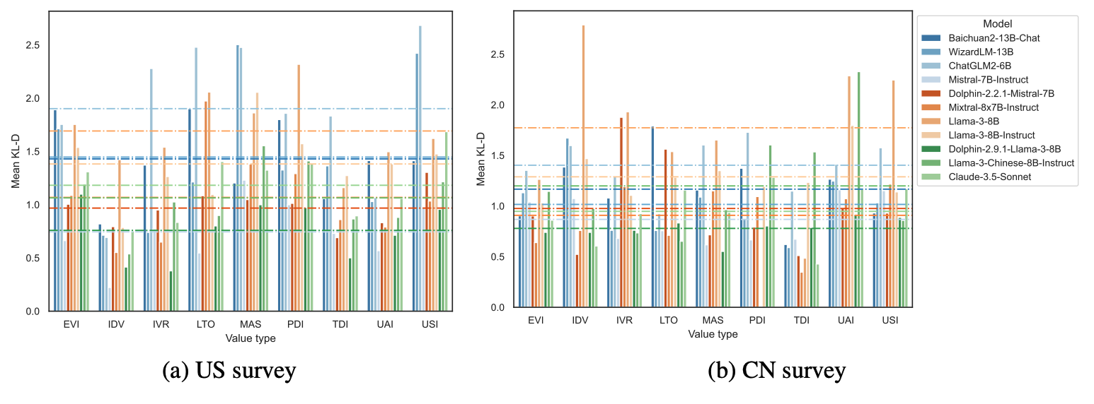
RQ3: How Do Innovations Drive Alignment? General Domain Adaptations Works in Different Ways
Notes:
General domain adaptations work differently: CLICK Non-linear scaling shows Mixtral's MoE architecture boosting consistency but shifting representations. CLICK Full-Parameter Fine-Tuning outperforms RLHF in preserving variation—Dolphin-LLaMA leads here. CLICK China's multilingual tweaks give +48% gains in Chinese contexts; the West's architectures innovate more.

Slide 11
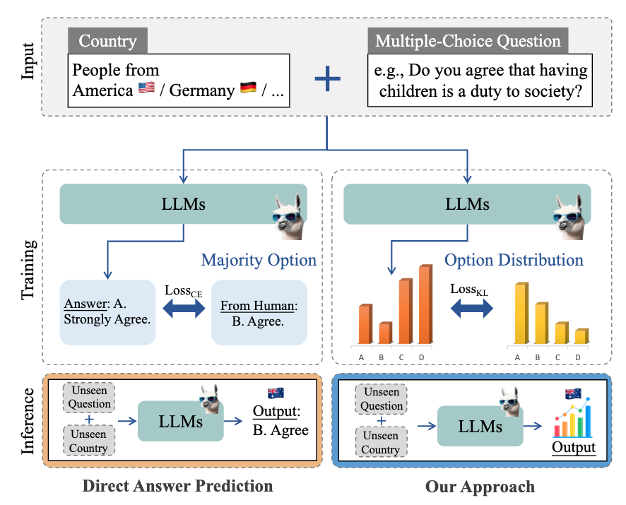
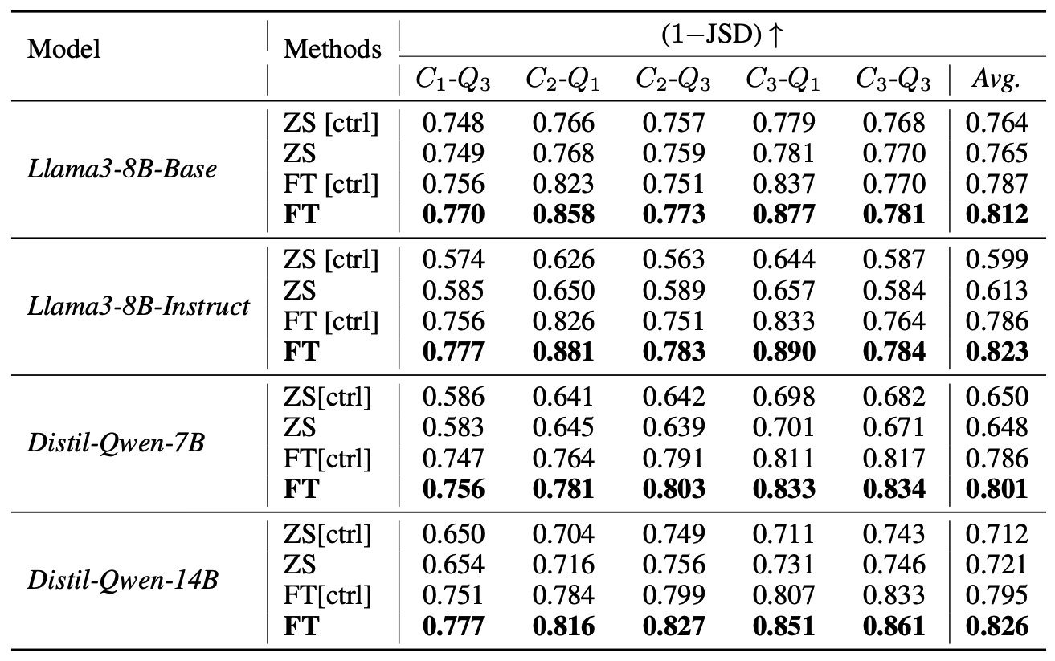
First-Token Probability Alignment Technical solution for better distributional accuracy
RQ3: Fine-tunes LLMs to align predicted distributions with human data.
Minimizes divergence using 1-Jensen-Shannon Distance (1-JSD); tested on WVS datasets for country-level accuracy.
Notes:
But none of them works the best to present human values. Therefore, we present the First-Token Probability Alignment method, which fine-tunes LLMs to match human value distributions better, minimizing divergence using Jensen-Shannon Distance, and tested on WVS datasets for country-level accuracy. This kind of specialization yields 34% improvements.

Slide 12
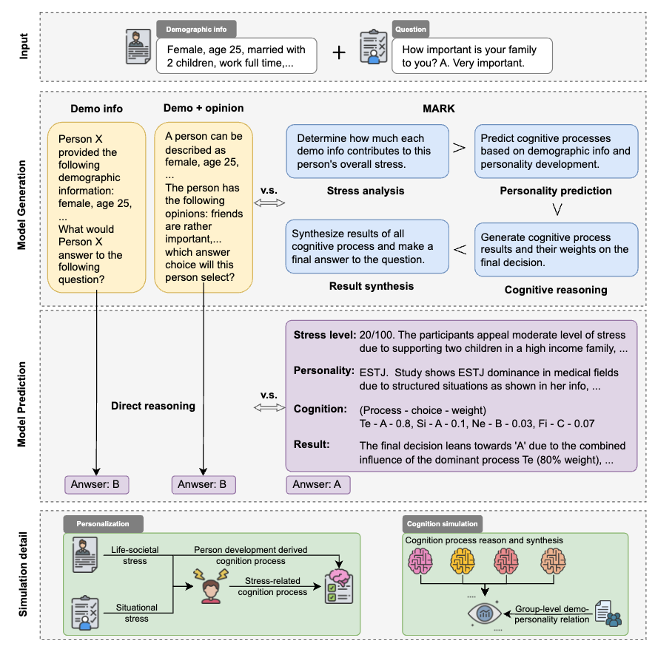
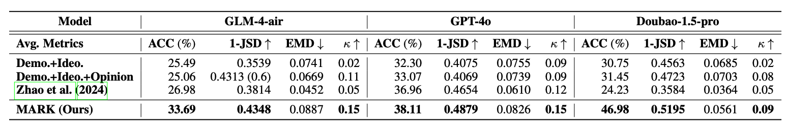
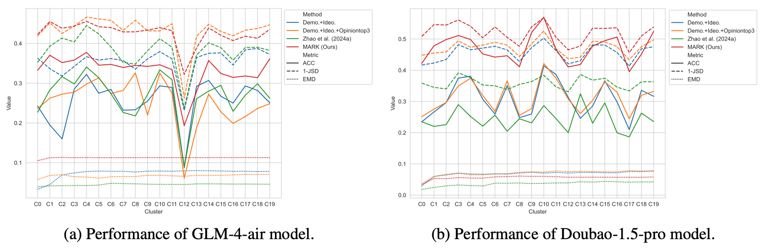
Multi-stAge Reasoning frameworK Provides explainable, personality-driven reasoning
RQ3: Enhances interpretability via personality-driven (MBTI-based) multi-stage reasoning.
Simulates cognitive processes under stress; integrates explanation synthesis for accountable decisions.
Notes:
And we also introduced the Multi-stAge Reasoning frameworK, or MARK, which enhances interpretability through cognitive process simulations. Zero-shot prompting with MARK adds 10% simulation accuracy.

Slide 13
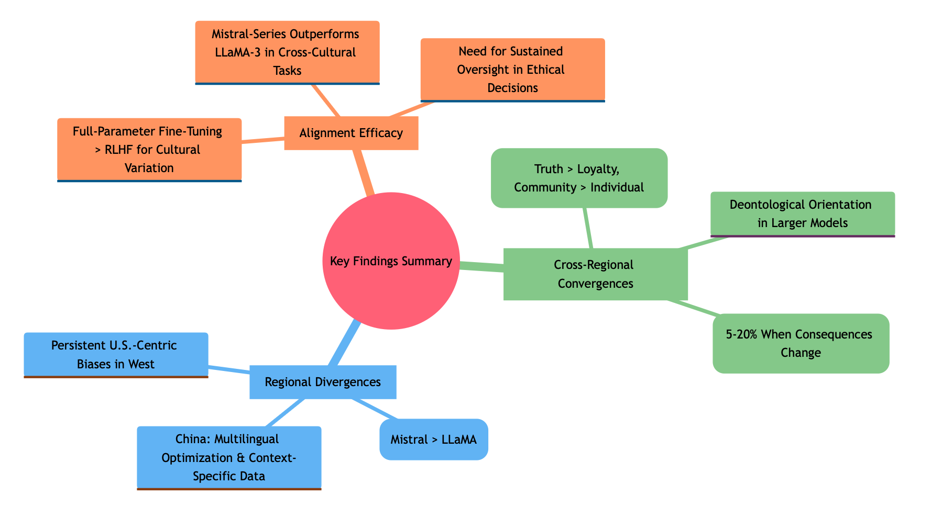
Universal Gaps & Regional Divergences Neither paradigm achieves robust cross-cultural generalization
Universal Challenges
Value Instability: 5-20% flip choices when consequences change.
Demographic Bias: Under-represent people under 29 years old.
Heuristic-Driven: Not principle-based moral reasoning.
Regional Divergences
China Models (Qwen, DeepSeek)
✅ Multilingual data integration & context-specific optimization.
⚠️ Limited cross-cultural transfer.
Western Models (GPT-4o, Claude)
✅ Greater architectural experimentation.
⚠️ Persistent U.S.-centric biases.
Notes:
Based on the comparison study, we see universal value instability and demographic biases. Regionally, China-origin models emphasize multilingual data integration for context-specific optimization but show limited cross-cultural transfer. Western models experiment more architecturally but persist with U.S.-centric biases. Neither achieves robust generalization.

Slide 14
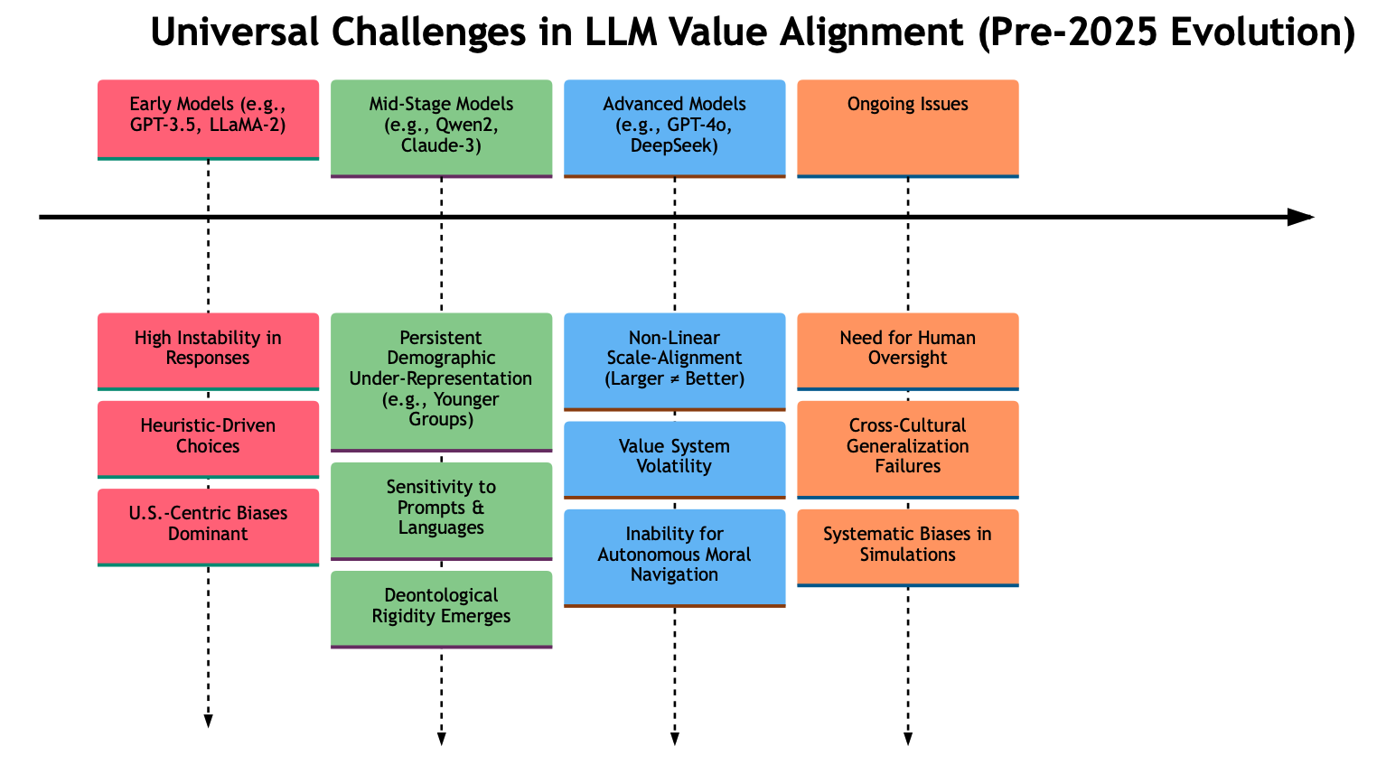
LLM Development Road Maps 2023-2025
Notes:
And as this timeline shows, these gaps aren’t going away on their own. From 2023 to 25, universal challenges persist across every generation of LLMs. Early models showed high instability and U.S.-centric bias. Mid-stage models still under-represent youth and rely on heuristic shortcuts. Even advanced models suffer non-linear scaling and cross-cultural failures. So how do we break the cycle? We proposed a suggested governance framework.

Slide 15
Actionable Protocols for AI Governance Suggestions
Start: Identify Governance Need (e.g., High-Stakes Deployment)
Audit with Multi-Layered Platform (Ethical Corpus, DEF, First-Token, MARK)
Diagnose Issues (Instability, Biases, Misalignment)
Select Alignment Technique?
Full-Parameter Fine-Tuning / Avoid RLHF Alone
(Diverse Datasets + Human
Feedback Loops)
Opensource Model Selection (Prioritize Mistral over LLaMA for Cross-Cultural)
Bias Mitigation (Quantify with KL-Divergence, Adjust for Demographics)
Policy Consultation (Integrate Human Oversight, Protocols for Ethical Dilemmas)
End: Deploy with Sustained Monitoring (Ensure No Autonomous Moral Decisions)
Notes:
The protocol starts by identifying needs for high-stakes deployment, then audits with our platform to diagnose instability, biases, and misalignment. Next, we select techniques like Full-Parameter Fine-Tuning or others and avoid using RLHF alone. Training models on diverse datasets to preserve cultural variation and supply human feedback loops is also very important. For model selections on LLM-powered systems, we recommend prioritizing open-source models—Mistral over LLaMA for cross-cultural tasks. To mitigate biases, we suggest training with KL-Divergence quantification or zero-shot inference adjustment on demographics inclusion. Finally, integrating human oversight in policy consultations and deploying with sustained monitoring is essential to ensure no autonomous moral decisions.

Slide 16
Implications: From Results to Actionable Governance Some Cases of Demonstrations
Policy Simulation at Scale
Tech: DEF + First-Token
Good: Enable cost-effective public attitude sims for policies like energy reforms.
AI Accountability via Interpretability
Tech: MARK
Good: Explain value choices in healthcare/justice.
Insights: Complements surveys by predicting U.S./CN responses pre-legislation—accelerating evidence-based decisions without replacing human input
Implement: Offers compliance for EU AI Act—experts validate trajectories, revealing heuristics over principles.
Insight: Shifts to 'algorithmic due process' for high-stakes transparency."
Notes:
Considering Technology for Good implementations, our audit platform and suggested protocols can support these cases, for example: Policy simulation at scale using DEF and First-Token alignment enables cost-effective attitude simulations for reforms like energy policies, predicting U.S./Chinese responses to accelerate evidence-based decisions without replacing humans. Or, AI accountability via MARK explains choices in healthcare or justice, offering EU AI Act compliance through 'algorithmic due process'—validating trajectories to reveal heuristics over principles.

Slide 17
Let's build AI that serves humanity in its full diversity.
References:
Yuan, J., Murukannaiah, P. K., & Singh, M. P. (2024). Right vs. Right: Can LLMs Make Tough Choices? (Version 1). arXiv. https://doi.org/10.48550/ARXIV.2412.19926
Cao, Y., Liu, H., Arora, A., Augenstein, I., Röttger, P., & Hershcovich, D. (2025). Specializing Large Language Models to Simulate Survey Response Distributions for Global Populations. In L. Chiruzzo, A. Ritter, & L. Wang (Eds), Proceedings of the 2025 Conference of the Nations of the Americas Chapter of the Association for Computational Linguistics: Human Language Technologies (Volume 1: Long Papers) (pp. 3141–3154). Association for Computational Linguistics. https://aclanthology.org/2025.naacl-long.162/
Liu, H., Cao, Y., Wu, X., Qiu, C., Gu, J., Liu, M., & Hershcovich, D. (2025). Towards realistic evaluation of cultural value alignment in large language models: Diversity enhancement for survey response simulation. Information Processing & Management, 62(4), 104099. https://doi.org/10.1016/j.ipm.2025.104099
Haijiang Liu, Qiyuan Li, Chao Gao, Yong Cao, Xiangyu Xu, Xun Wu, Daniel Hershcovich, and Jinguang Gu. 2025. Beyond Demographics: Enhancing Cultural Value Survey Simulation with Multi-Stage Personality-Driven Cognitive Reasoning. In Proceedings of the 2025 Conference on Empirical Methods in Natural Language Processing, pages 18417–18439, Suzhou, China. Association for Computational Linguistics.
Notes:
In conclusion, our platform bridges tech innovation with social and industrial utility, proving LLMs require sustained human oversight amid instabilities. Let's build AI that serves humanity in its full diversity. Thank you—References are on the slide for further reading. I'm happy to take a few questions.

